Slide 1

Power BI Sales Analytics Dashboard
RAJ RAMJI JAISWAL

Slide 2
Agenda
1
2
3
4
5
Overview
Features & KPIs
Dashboard Highlights
Benefits & Conclusion
Summary

Slide 3

Project Overview
Title: Interactive Sales Dashboard for Business Insights Objective: To develop a professional and interactive Power BI dashboard that visualizes key sales, profit, and customer data. This helps business stakeholders quickly understand performance trends and make data-driven decisions. Dataset: The dashboard uses a sample sales dataset from Kaggle, containing detailed sales transactions, customer profiles, product information, and a date table for time-based analysis.

Slide 4
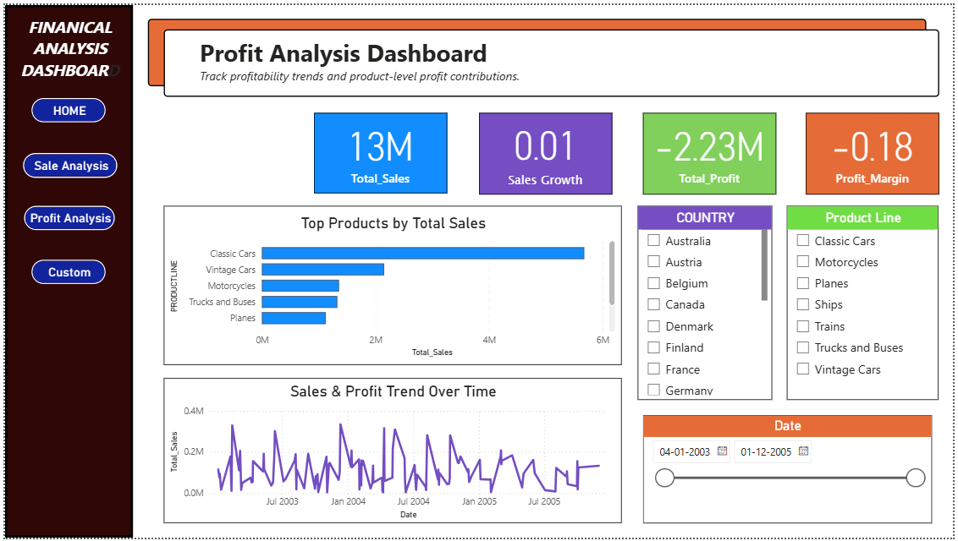
KPIs Displayed:
Total Sales: Overall revenue generated
Total Profit: Net profit after costs
Profit Margin: Profit as a percentage of sales
Sales Growth: Year-over-year increase in sales
Interactive Elements:
Navigation buttons allow users to switch seamlessly between different analysis pages.
Visuals are clickable and filter each other dynamically, offering interactive insights without cluttering the report with slicers.
Pages Included:
Summary: Executive overview of metrics
Sales Analysis: Breakdown by product and region
Profit Analysis: Profit trends and key products
Customer Insights: Top customers and sales demographics

Slide 5
Dashboard Highlights
Summary Page:
Provides high-level KPIs and trends with clean visuals for quick decision making.
Sales Analysis:
Displays detailed sales figures by product categories and geographic regions to identify best-selling products and markets.
Profit Analysis:
Focuses on profit distribution, highlighting the most profitable products and regions over time.
Customer Insights:
Offers valuable information on top customers and their buying patterns, helping to tailor marketing strategies.

Slide 6
Business opportunities are like buses. There’s always another one coming.
“
”
Richard Branson

Slide 7
Benefits & Conclusion
Benefits
This interactive dashboard provides clear, actionable insights that help drive smarter business strategies and operational improvements.
By visualizing key metrics such as sales, profit, and customer trends, stakeholders can make faster, data-backed decisions.
Conclusion
The dashboard’s intuitive navigation and dynamic visuals offer a smooth user experience while maintaining a clean layout.
Built with scalability in mind, it can be easily extended with new datasets or KPIs as business requirements grow.

Slide 8
SUMMARY
Objective​
Implementation
Outcome
The goal of this project was to design a professional and interactive dashboard using Power BI that provides meaningful insights into sales performance, profitability, and customer behavior.
The dashboard is aimed at helping business stakeholders make informed and strategic decisions.
Used a sales dataset from Kaggle and created data relationships between sales, customers, products, and a date table.
Built four main report pages with calculated KPIs, interactive charts, and navigation buttons for a smooth user experience.
The final dashboard is clean, dynamic, and easy to use.
It highlights key metrics and trends, enables visual-level filtering, and supports business strategy with actionable insights. It is also scalable for future datasets and KPIs.

Slide 9
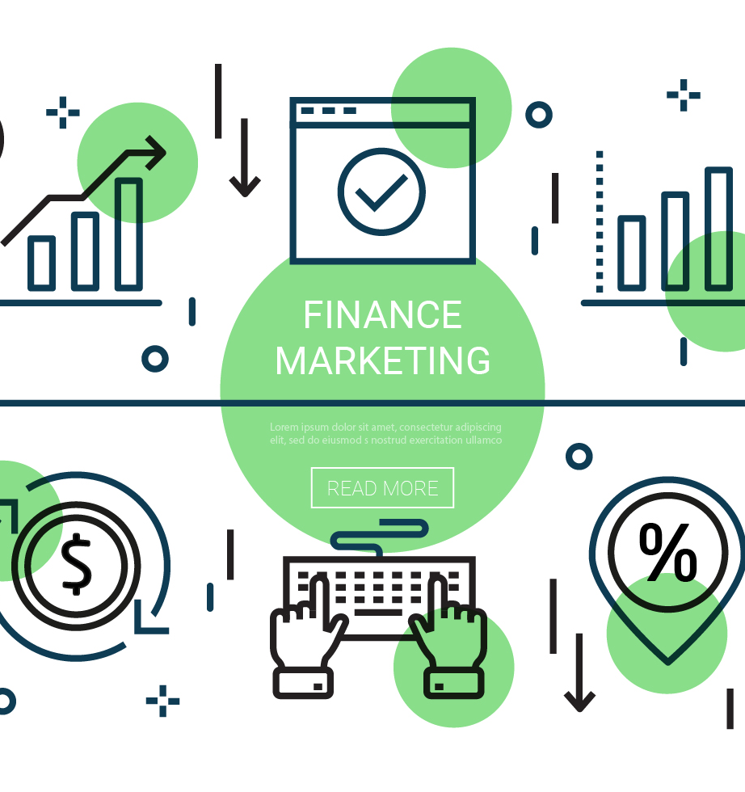
Thank you
Raj Ramji Jaiswal
rajjaiswal@example.com

